Slide 1

BSc. in International Business and Politics
Political Science:
Participation and Representation
(in democracies)
Filip Kiil
Office hour (Monday 7/9 17:15-18:15)
fk.egb@cbs.dk
External lecturer
Department of International Economics, Government and Business

Slide 2
Stucture
Federalism and recap
Part 1: Core Institutions and Actors
  Introduction
  Electoral Systems: SMD, PR, Mixed
  Party Systems and Parties: numbers, strength, origins, ideology, members, mobilization, and challenges to party democracy
  Civil Society: models of government–interest group interaction
Part 2: Case Studies
  UK, Germany, Japan, Brazil

Slide 3
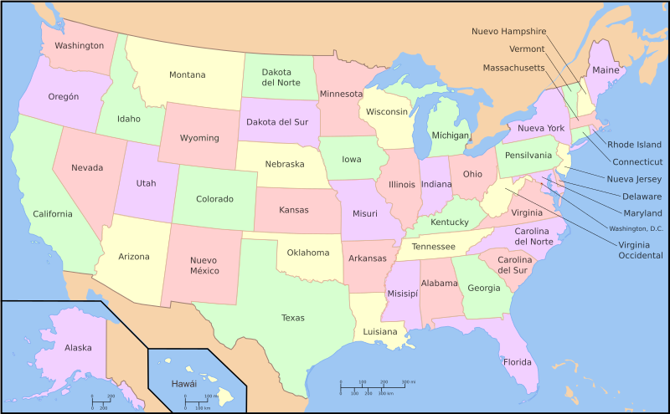
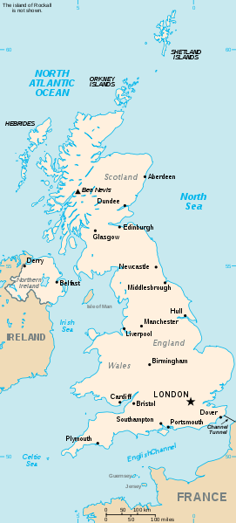
Federalism vs. Unitary States
Feature | Federal | Unitary
Power | Shared between national govt & regions | Centralized in national govt
Local Autonomy | Guaranteed by constitution | Granted/revoked by center
Institutions | Often bicameral, regional voice | Usually unicameral
Examples | U.S., Germany, | France, UK, Denmark
Notes:
Are there elements of federalism in denmark?

Slide 4
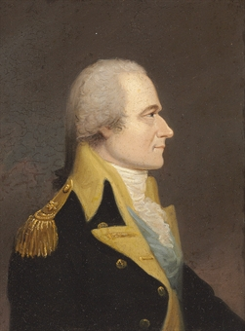
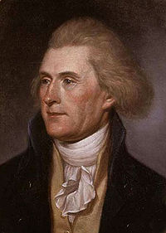
Federalism
Federalism in the US
Declare war and foregin policy
Government
Federal level
National
[Hamilton]
Law and order
Schools
States
Regional level
Sub-national
[Jefferson]
Taxes
Local governments
Admit new states
Borrowing
Public
welfare
Coin money
Public safety

Slide 5
Federalism
Why Federalism?
Brings govt closer to people (large/diverse states).
Limits majority power via decentralization & veto players.
Protects minorities through regional autonomy.
Accountability
Depends on subnational powers & revenue control.
Enhances local accountability but can hinder national consistency.

Slide 6
Recap Systems of government
Majoritarian vs. consensus democratic systems
Veto player theory
Parliamentarism, presidentialism and semipresidentialism
The judiciary and its role in horizontal accountability
Bureaucracy

Slide 7
Learning objectives
Explain the various types of electoral systems and the advantages and disadvantages of each.
Discuss the functions of party systems and political parties.
Provide a definition of modern civil society and explain how interest-group pluralism and corporatism differ
Use evidence from several countries to compare and explain how different electoral systems, parties, and types of civil society contribute to political representation.

Slide 8
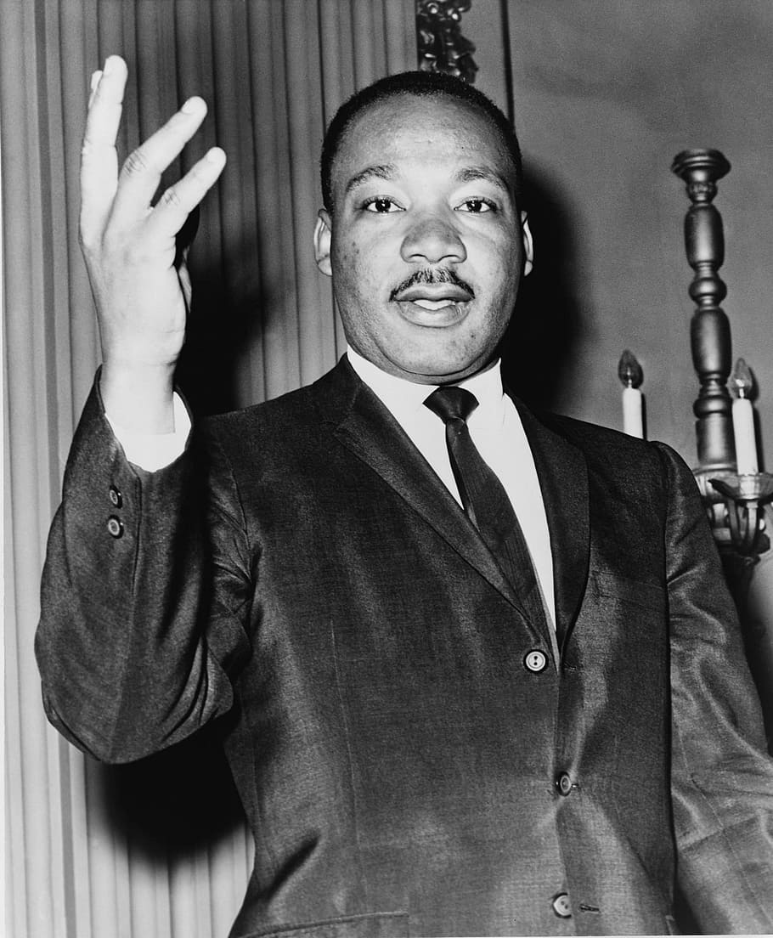
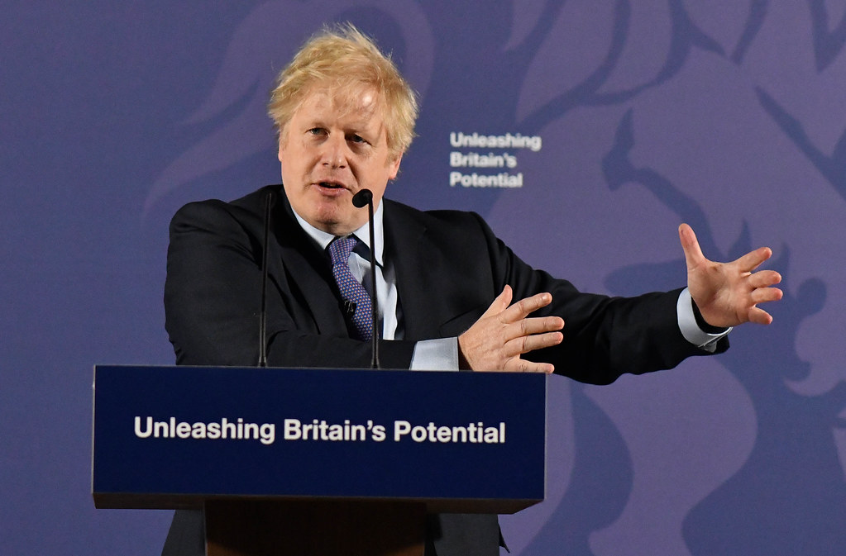
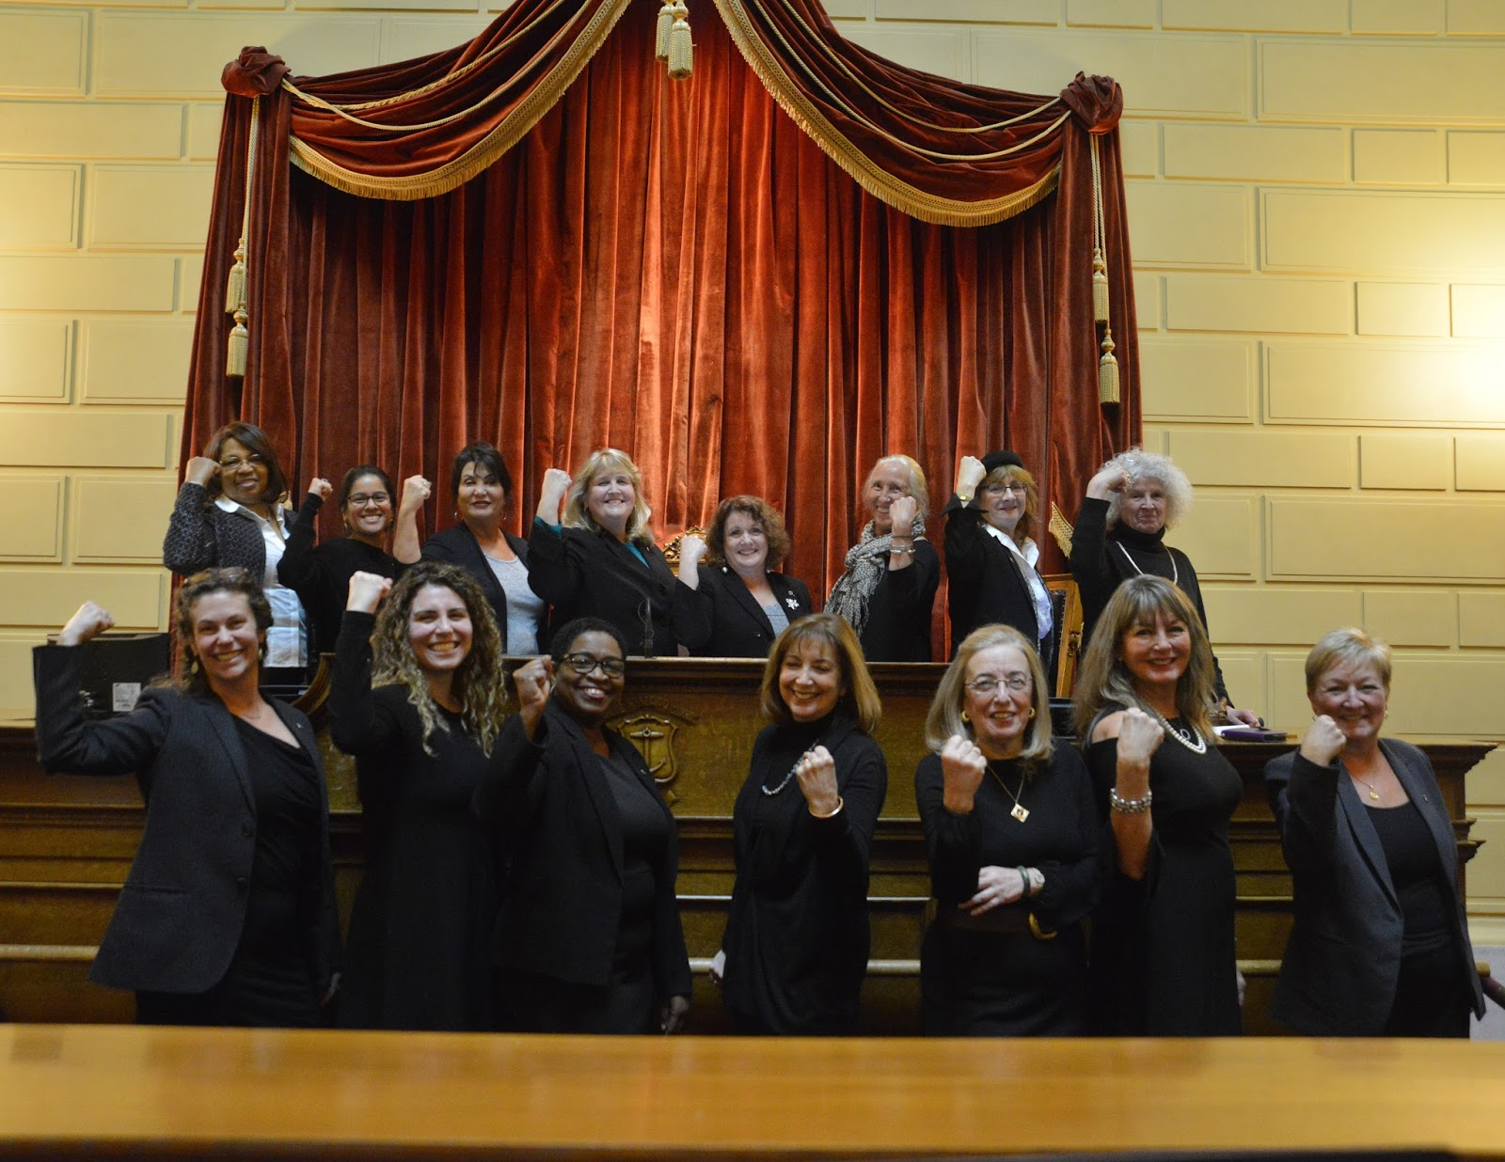
Why does it matter?
Participation and representation matters for legitimacy in democracies.
Participation and representation matters for accountability.
Participation and representation matters for policy.
This Photo by Unknown Author is licensed under CC BY-NC-ND
This Photo by Unknown Author is licensed under CC BY
This Photo by Unknown Author is licensed under CC BY-SA
Notes:
When citizens participate by voting, and when their elected representatives truly reflect the population, the government is seen as legitimate.
When people participate through voting and other forms of engagement, they can hold their leaders accountable.
When people participate and are represented, the policies created are more likely to meet the needs and desires of the general public.

Slide 9
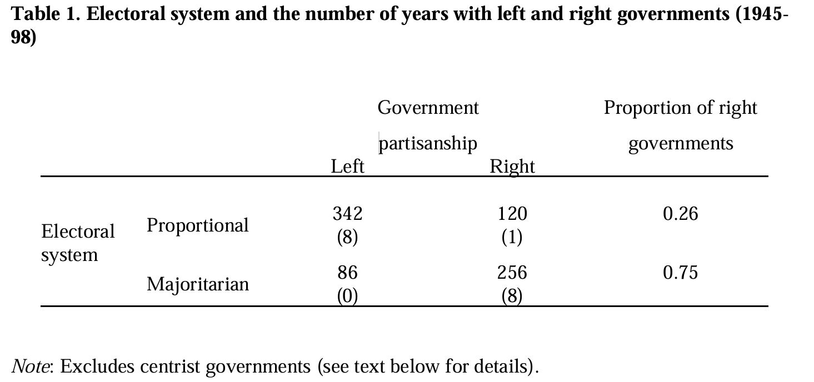

From Iversen Torben, and David Soskice. 2006. “Electoral Systems and the Politics of Coalitions: Why Some Democracies Redistribute More Than Others.” American Political Science Review 100 (May): 165– 81.

Slide 10
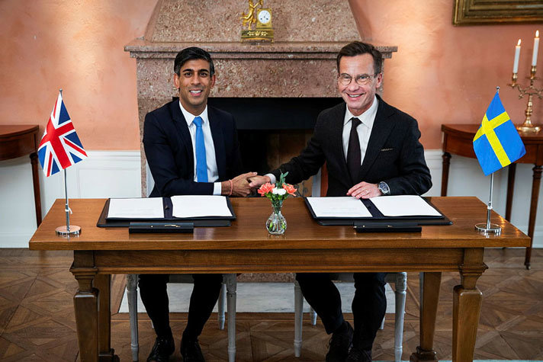
Notes:
23
62 (43 in a row)

Slide 11
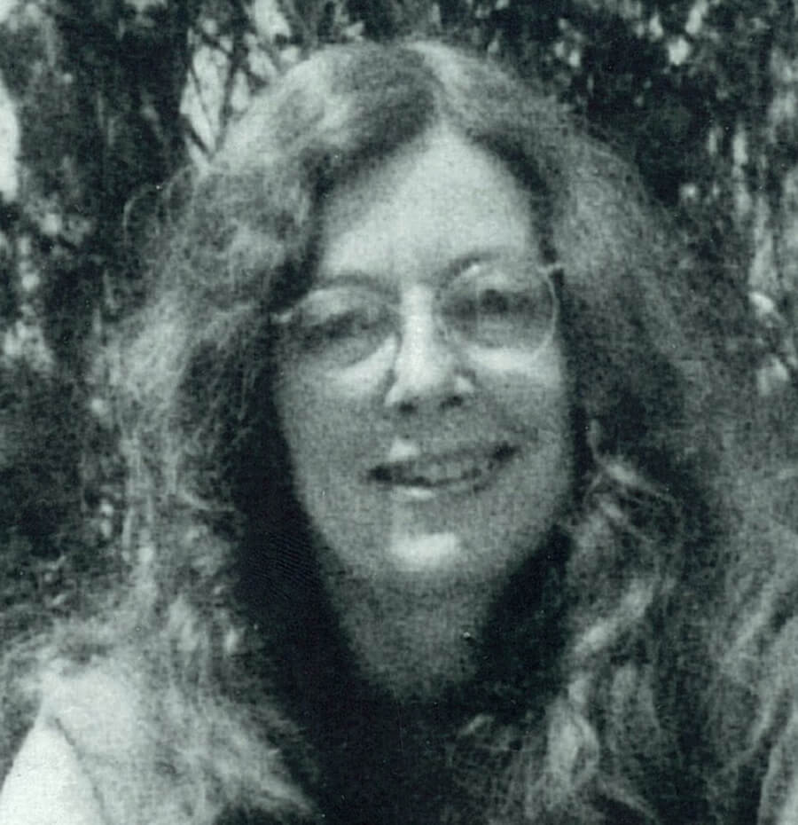
Introduction
General considerations
Representation: descriptive (look) vs. substantive (act) (Pitkin 1967).
Elite dominance limits marginalized influence.
Participation: low individual impact (Downs 1957) vs. expressive/emotional benefits.
Institutions (electoral rules, party systems, civil society) enable or constrain participation and representation.

Slide 12
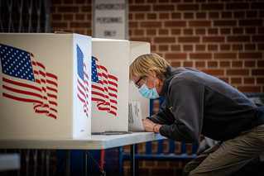
Electoral Systems
Electoral systems
Translate votes into legislative/government power.
Types: SMD, PR, Mixed.
Shape representation of interests and government stability.
Affect party numbers and strength.
Influence democracy: majoritarian (fewer parties) vs. consensual (more parties).
This Photo by Unknown Author is licensed under CC BY

Slide 13
Electoral Systems
Single-Member Districts (SMD)
One representative per district.
Types: First Past the Post (FPTP) (plurality wins) vs. majoritarian (absolute majority, runoff).
Virtual representation - indirect party-based representation.
Advantages: Strong voter–representative link; supports majoritarian democracy.
Criticisms: Wasted votes, biased party representation, gerrymandering risks.
Notes:
UK Green carding

Slide 14
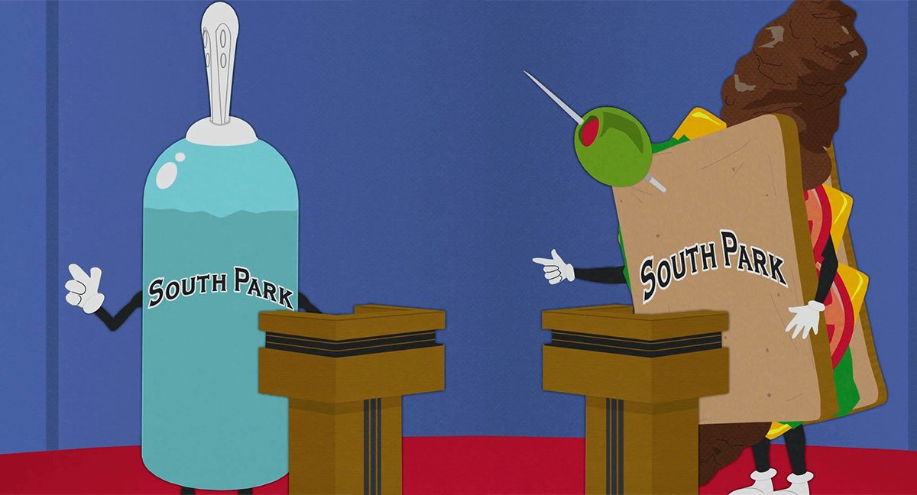

Slide 15
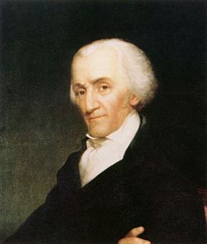
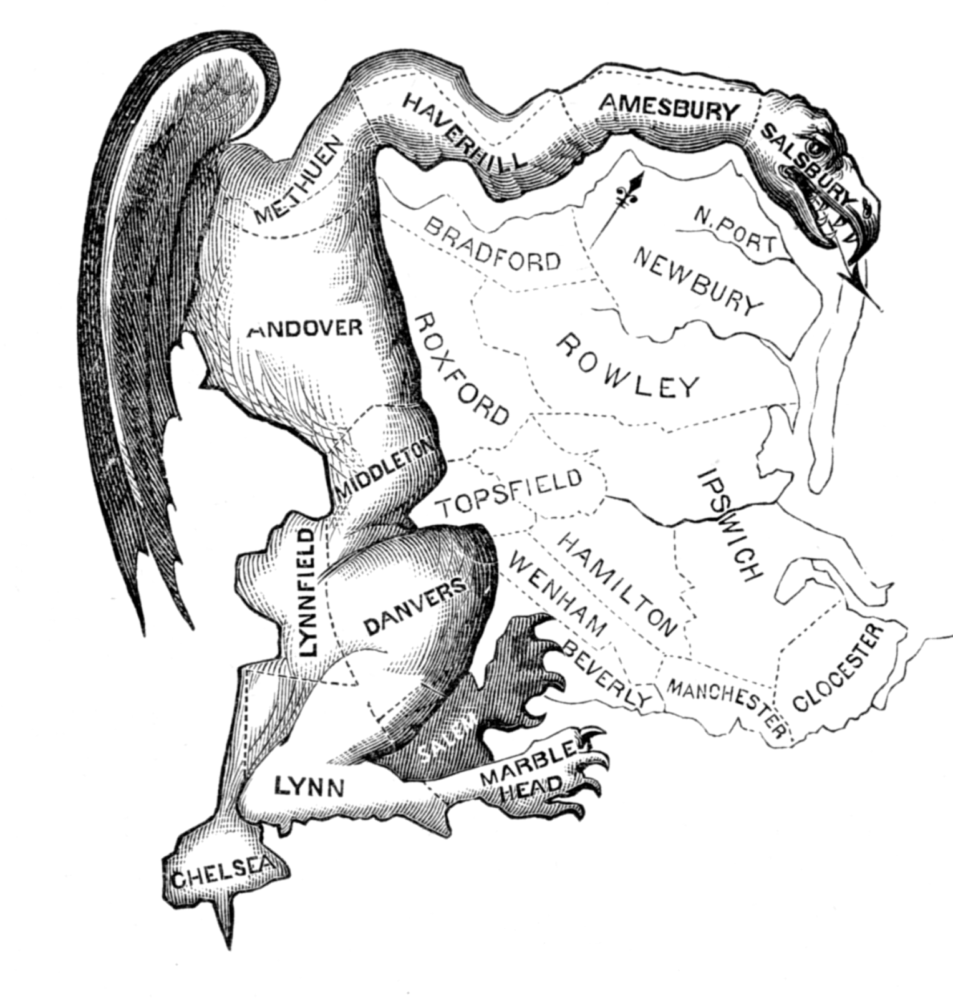
Electoral Systems
Elbridge Gerry Salamander = Gerrymander
This Photo by Unknown Author is licensed under CC BY-ND
Notes:
1812, USA

Slide 16
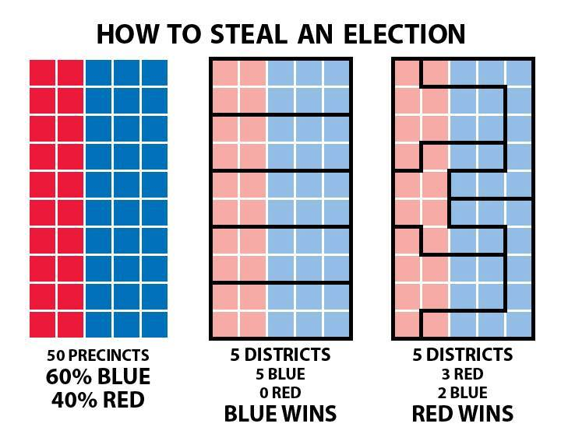
Electoral Systems
Gerrymandering

Slide 17
Electoral Systems
Proportional Representation (PR)
Seats allocated by vote share (above threshold).
Types: Closed-list (vote for party), Open-list (vote for candidates).
Advantages: Fewer wasted votes, higher turnout, diverse representation.
Criticisms: Weaker voter–representative link, fragmented parliaments, small extremist parties.
Notes:
Why higher turnout?

Slide 18
Electoral Systems
Mixed, or Semiproportional, Systems
Combine SMD and PR for balance of representation and proportionality.
Two ballots: one for district candidate, one for party list.
Examples: Compensatory (Germany), Non-compensatory (Japan).
Advantages: Stability with major parties + proportional fairness.
Criticisms: Complex rules, unclear vote–seat translation.

Slide 19
Party Systems
Parties and party systems (numbers and strength)
Parties: Mobilize citizens, recruit elites, simplify choices, organize government, provide opposition.
Types of party systems:
Dominant-party: One party prevails (e.g., ANC, South Africa).
Two-party: Two main competitors (e.g., U.S.).
Multiparty: Several parties compete, coalitions form (e.g., Germany).
Notes:
Above 50 percent. 2024: 40.2%

Slide 20
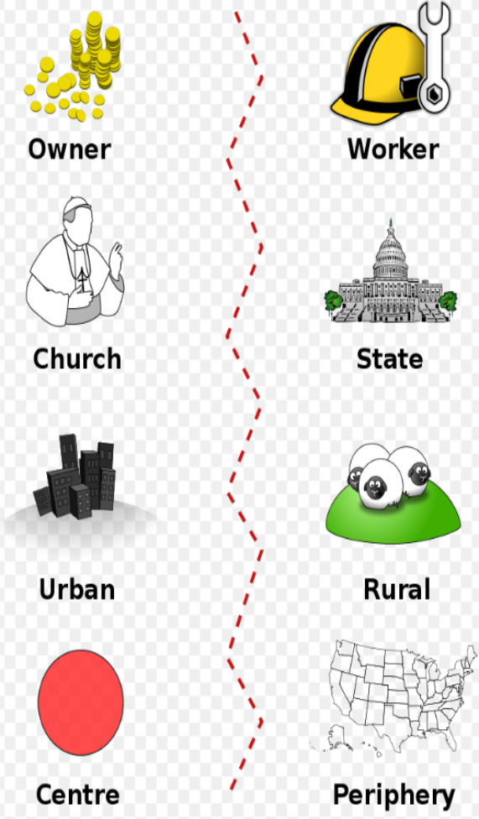
Party Systems
Origins of Party Systems
Sociological: Reflect social structures in terms of cleavages between groups (economic, religious, social).
Institutional: Shaped by electoral systems (Duverger’s Law).
Dynamics: Party systems shift with changing social structures and rules.

Slide 21
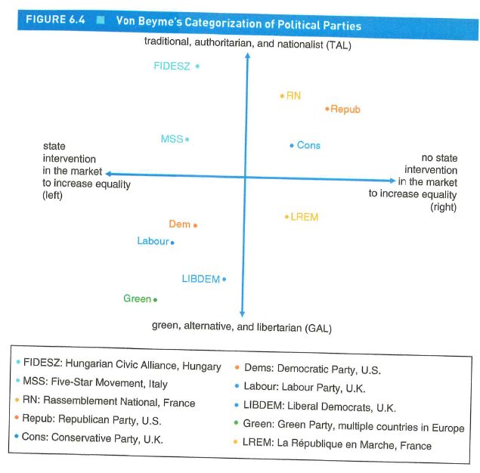
Party Systems
Political Parties: Ideology, Members, and Mobilization
Ideology:
Economic: Left–Right.
Cultural: GAL–TAN.
Mobilization Types:
Programmatic (ideology-driven).
Patronage (material benefits).
Populist (direct leader–voter appeals).
Notes:
GAL (Green–Alternative–Libertarian): progressive, cosmopolitan, pro-environment, individual rights.
TAN (Traditional–Authoritarian–Nationalist): conservative, order-focused, nationalist, traditional values.

Slide 22

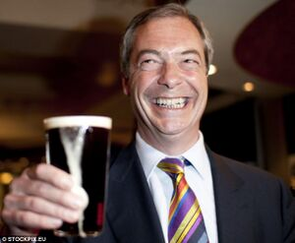
Party Systems
A Crisis of Party Democracy?
Declining confidence in traditional parties; rise of populism.
Causes: Inequality, cultural backlash, party failures.
Effects: Electoral volatility, fragmentation, democratic strain.
Debates: Consequences for democracy, prospects for reform.
This Photo by Unknown Author is licensed under CC BY-SA
This Photo by Unknown Author is licensed under CC BY-SA

Slide 23
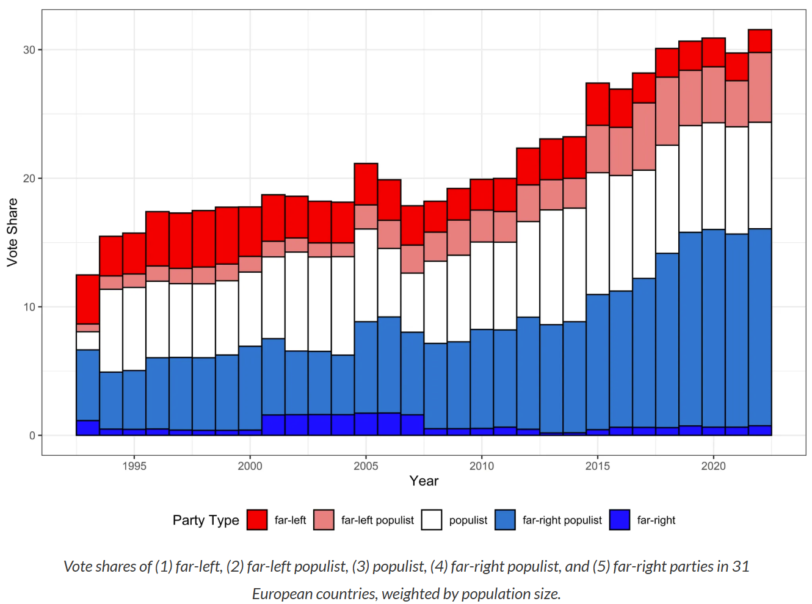
What is populism, and do its drivers vary across party types?
Source: Rooduijn, Matthijs, et al. "The PopuList: A database of populist, far-left, and far-right parties using expert-informed qualitative comparative classification (EiQCC)." British Journal of Political Science 54.3 (2024): 969-978.

Slide 24

Civil Society
Non-violent, organized activity outside government control.
Space for citizens to organize & influence policy.
Includes interest groups (influence without office).
Key questions: Democratic rules? Representation? Impact on democracy?
This Photo by Unknown Author is licensed under CC BY-ND
Notes:
Republican view= threat / Liberal view = source of liberty

Slide 25
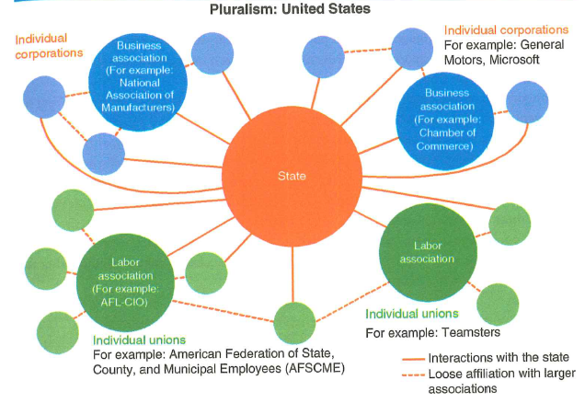
Civil Society
Two Models of Government-Interest Group Interaction
Pluralism: many groups represent the same interests while the government neutral (e.g., U.S.).
Strengths: Local participation, flexibility, open access.
Weaknesses: Fragmentation, weak collective voice.

Slide 26
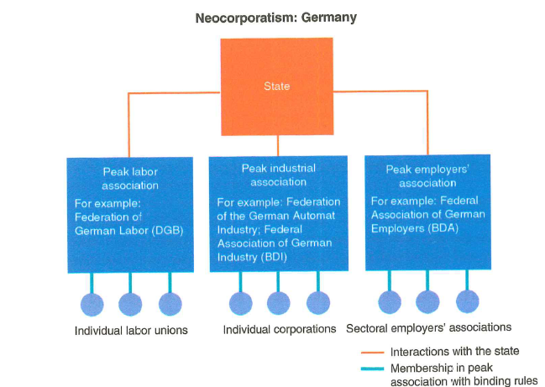
Civil Society
Two Models of Government-Interest Group Interaction
Neocorporatism: Few large peak associations formally recognized (e.g., Germany).
Strengths: Centralized, direct access to government, broad representation.
Weaknesses: Limited participation, elite dominance, barriers for new groups.

Slide 27
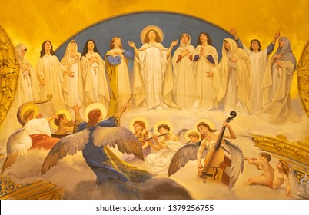
Civil Society
E.E. Schattschneider:
”The flaw in the pluralist heaven is that the heavenly chorus sings with a strong upper-class accent”

Slide 28
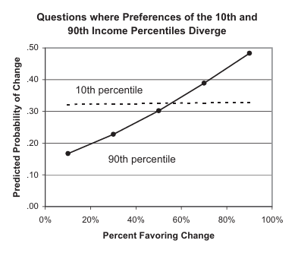

Slide 29
Take away
Electoral Systems: SMD (FPTP, Majoritarian), PR (Closed-list, Open-list), Mixed (Compensatory vs. Non-compensatory).
Party Systems: Dominant-party, Two-party, Multiparty.
Civil Society Models: Pluralism vs. Neocorporatism; Republican vs. Liberal views

Slide 30


Slide 31
The four cases
While we walk through the four cases from the book, please consider the following question:
How do electoral systems, party systems, and civil society shape political representation across the four cases?

Slide 32
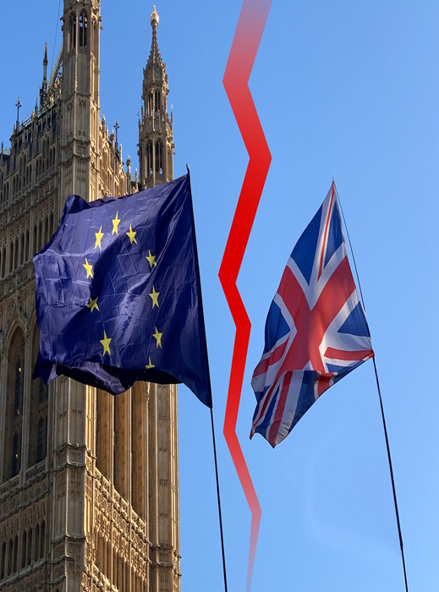
The United Kingdom
Electoral and Party System
SMD + FPTP → traditional two-party dominance.
Labour & Conservatives dominate; smaller parties (Lib Dems, SNP) persist.
Declining major party support, coalition gov, rise of new parties (e.g., Reform UK).
2011 referendum upheld FPTP system.
Notes:
Labour 411 seats (33.7%); Conservatives 121 (23.7%); Liberal Democrats 72 (12.2%); Reform UK 5 (14.3%); Green Party 4 (6.4%); Your Party 0 (—)
Before WW1: Gladstone, Asququith overtaken by Labour

Slide 33
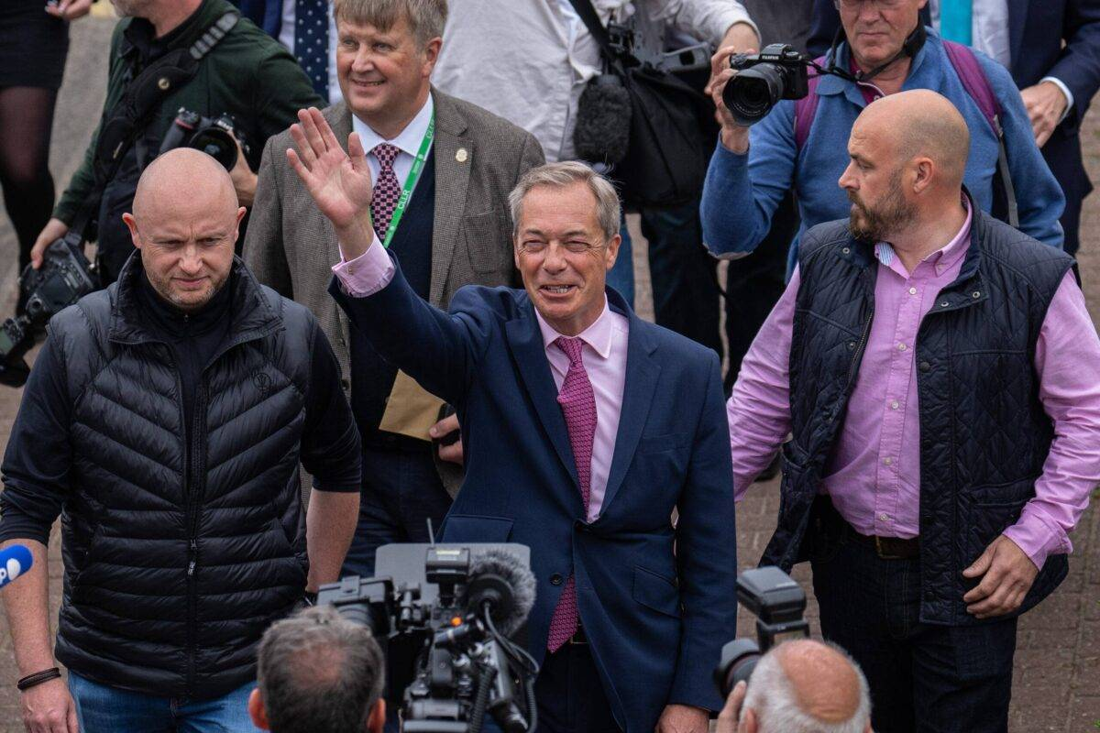
The United Kingdom
Civil Society in the UK
Pluralist tradition with shifting influence of interest groups.
Key groups: CBI (business), TUC (labor).
Rise of new movements (e.g., environment, Brexit).
Influence depends on ruling party alignment & access.
This Photo by Unknown Author is licensed under CC BY-SA-NC

Slide 34
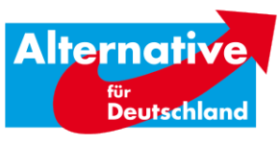
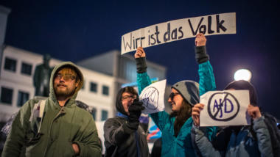
Germany
Electoral and Party System
Mixed proportional system → multiparty structure.
Traditionally CDU/CSU & SPD + smaller coalition partners (FDP).
New actors: Greens, Left Party, AfD challenge dominance.
Increasing fragmentation → coalition governments.
This Photo by Unknown Author is licensed under CC BY-SA-NC
This Photo by Unknown Author is licensed under CC BY-NC
Notes:
CDU/CSU: Christlich Demokratische Union Deutschlands / Christlich-Soziale Union in Bayern; Sozialdemokratische Partei Deutschlands; Freie Demokratische Partei

Slide 35
Germany
Civil Society in Germany
Neocorporatist model: strong peak associations.
Key actors: Trade Union Federation, Business associations, sectoral groups.
Declining influence: globalization, labor market change, shifting alliances.
Traditional state–business–labor cooperation under strain.

Slide 36
Japan
Electoral and Party System
1994: Major reform → mixed system.
2009: Democratic Party of Japan ended Liberal Democratic Party dominance.
2012: Liberal Democratic Party returned to power and still rules.
Electoral reform had limited impact on Liberal Democratic Party dominance.
Low voter turnout; weak, regulated civil society.

Slide 37
Japan
Civil Society
Historically weak, tightly regulated by bureaucracy.
Dominated by business interests tied to government (“iron triangles”).
Trade unions relatively weak; business remains dominant.
1999 Nonprofit Organization Law aimed to strengthen civil society, but faced funding and aging challenges. Neighborhood associations provide social capital but struggle with demographic change.

Slide 38
Brazil
Electoral and Party System
Open-list PR for lower house.
High inter- & intraparty competition → weak party cohesion.
Candidates rely on local mobilization → fosters clientelism.
Weak, fragmented parties → complex coalition-building.
Workers’ Party (PT) began programmatic, later adopted clientelist practices.

Slide 39
Brazil
Civil Society
Roots in pro-democracy movement and 1988 Constitution.
2010s recession → mass protests over corruption and governance.
Impeachment of Dilma Rousseff marked a turning point.
Recent protests show deep polarization: pro- vs. anti-democracy movements.
Civil society remains central to political expression and societal divides.
Notes:
Rousseff (2011–2016) → Temer (2016–2018) → Bolsonaro (2019–2022) → Lula (2023–)

Slide 40
Comparing cases
Factor | UK | Germany | Japan | Brazil
Electoral System | FPTP → two-party dominance, now challenged post-Brexit | Mixed-member PR → multiparty coalitions, inclusive | Mixed SMD–PR → LDP dominance persists | Open-list PR → fragmented, clientelist politics
Party System | Traditionally two-party, third parties rising | Multiparty, coalition governments | LDP dominance, weak opposition | Fragmented, weak parties, clientelism
Civil Society | Pluralist, shifting toward new movements | Neocorporatis, declining influence | Weak, business-dominated, regulated | Strong but polarized; accountability limited

Slide 41
Recap of the lecture
1. Discuss with 1–2 people sitting next to you (3-4 minutes):
What were the most important points in today’s lecture?
Was anything unclear, surprising, or particularly interesting?
2. Plenary discussion.

Slide 42
Thanks!
- Next lecture is on Institutions and institutionalism

